Slide 1

My Linear Relationships Interactive Notebook
Name
Class
Term 3 Semester 2

Slide 2
Contents
Formula Page
Page
Date
Description
2
3

Slide 3
Tasks
24
7
30
Essential Question
Questions
Notes
Summary

Slide 4
24
7
30
Date
Finding the Equation of a line
EQ – Describe the method used for finding the equation of a line from the graph.

Slide 5
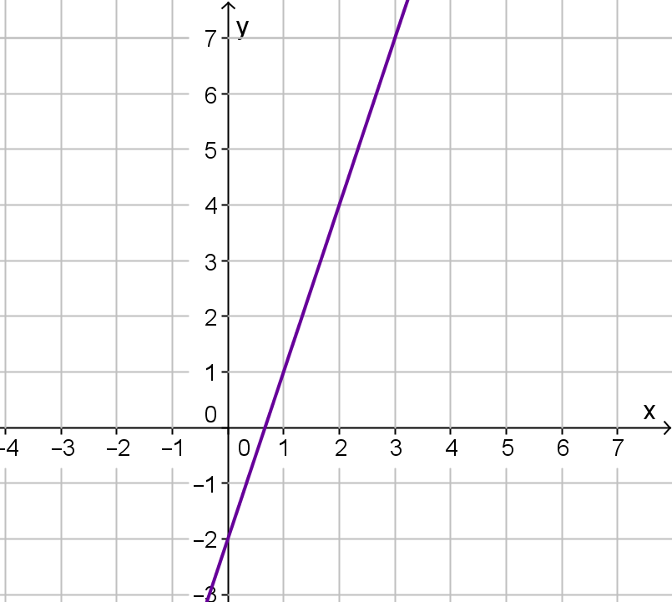
24
7
30
Date
Finding the Equation of a line
EQ – Describe the method used for finding the equation of a line from the graph.
What is the equation of the line?

Slide 6
24
7
30
Date
Finding the Equation of a line
EQ – Describe the method used for finding the equation of a line from the graph.
What is the equation of the line?
Find the gradient
Find the y-intercept of the line

Slide 7
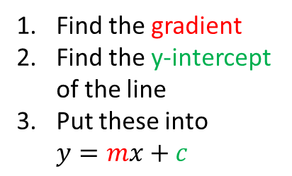
24
7
30
Date
Finding the Equation of a line
EQ – Describe the method used for finding the equation of a line from the graph.
What is the equation of the line?
Find the gradient
Find the y-intercept of the line
Put these into $y=mx+c$

Slide 8
24
7
30
Date
Finding the Equation of a line
EQ – Describe the method used for finding the equation of a line from the graph.
What is the equation of the line?
Find the gradient
Find the y-intercept of the line
Put these into $y=mx+c$
6

Slide 9

24
7
30
Date
Finding the Equation of a line
EQ – Describe the method used for finding the equation of a line from the graph.
What is the equation of the line?
Find the gradient
Find the y-intercept of the line
Put these into $y=mx+c$
6
m = $\frac{6}{2}=3$
2

Slide 10
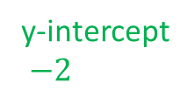
24
7
30
Date
Finding the Equation of a line
EQ – Describe the method used for finding the equation of a line from the graph.
What is the equation of the line?
Find the gradient
Find the y-intercept of the line
Put these into $y=mx+c$
6
m = $\frac{6}{2}=3$
2
y-intercept
$−2$

Slide 11

24
7
30
Date
Finding the Equation of a line
EQ – Describe the method used for finding the equation of a line from the graph.
What is the equation of the line?
Find the gradient
Find the y-intercept of the line
Put these into $y=mx+c$
6
m = $\frac{6}{2}=3$
2
y-intercept
$−2$
Equation $y=3x−2$

Slide 12
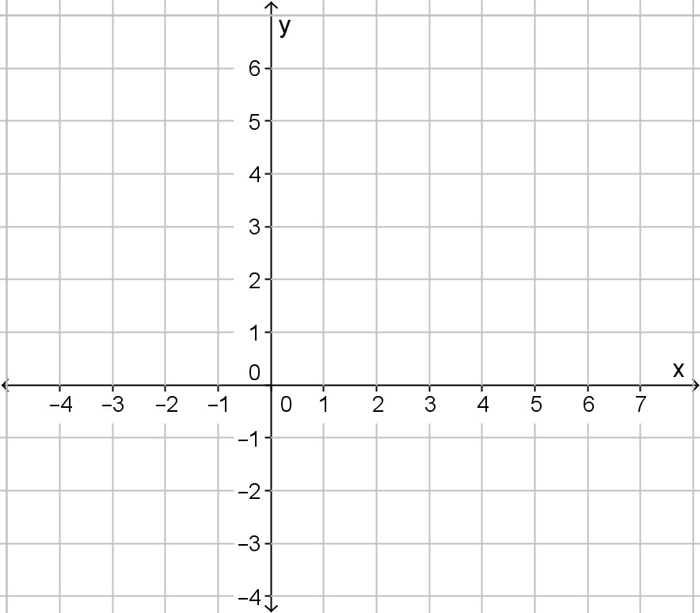
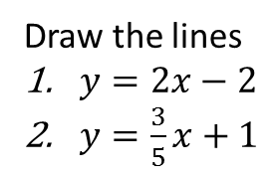
24
7
30
Date
Finding the Equation of a line
EQ – Describe the method used for finding the equation of a line from the graph.
Draw the lines
$y=2x−2$
$y=\frac{3}{5}x+1$

Slide 13
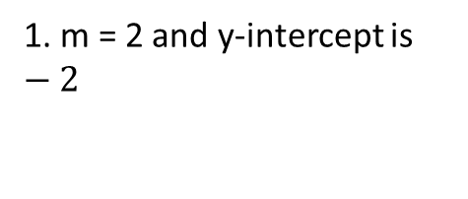
24
7
30
Date
Finding the Equation of a line
EQ – Describe the method used for finding the equation of a line from the graph.
Draw the lines
$y=2x−2$
$y=\frac{3}{5}x+1$
1. m = 2 and y-intercept is $−2$

Slide 14
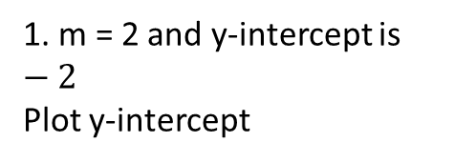
24
7
30
Date
Finding the Equation of a line
EQ – Describe the method used for finding the equation of a line from the graph.
Draw the lines
$y=2x−2$
$y=\frac{3}{5}x+1$
1. m = 2 and y-intercept is $−2$
Plot y-intercept

Slide 15
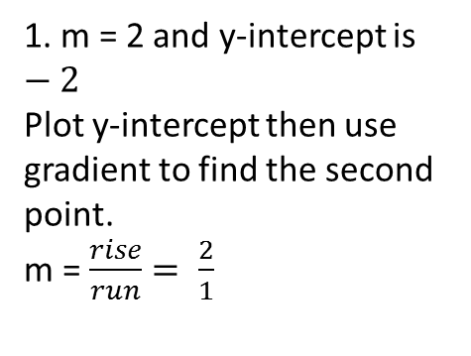
24
7
30
Date
Finding the Equation of a line
EQ – Describe the method used for finding the equation of a line from the graph.
Draw the lines
$y=2x−2$
$y=\frac{3}{5}x+1$
1. m = 2 and y-intercept is $−2$
Plot y-intercept then use gradient to find the second point.
m = $\frac{rise}{run}= \frac{2}{1}$
2
1

Slide 16
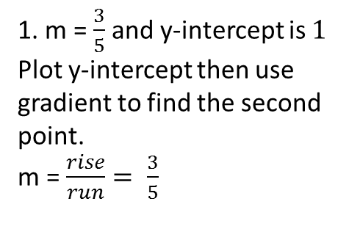
24
7
30
Date
Finding the Equation of a line
EQ – Describe the method used for finding the equation of a line from the graph.
Draw the lines
$y=2x−2$
$y=\frac{3}{5}x+1$
1. m = $\frac{3}{5}$ and y-intercept is $1$
Plot y-intercept then use gradient to find the second point.
m = $\frac{rise}{run}= \frac{3}{5}$
3
5

Slide 17
Questions

Slide 18
Notes Review
24, 7 ,30
Date
Title
Essential question
Notes complete
Notes complete with colour and diagrams
Questions completed
Contents page filed in
Formula page filled in

Slide 19
Homework
Review your notes and write a summary answering the essential question.

